Slide 1
Expressing an integer as a product of its prime factors
Properties of number: factors, multiples, squares and cubes

Slide 2
how to use Oak lessons

Slide 3
I can write any positive integer uniquely as a product of its prime factors.

Slide 4
A prime number is an integer greater than 1 with exactly two factors.
A product is the result of two or more numbers multiplied together.

Slide 5
A composite number is an integer with more than two factors. All integers greater than 1 are either composite or prime.
Prime factors are the factors of a number that are, themselves, prime.
Each composite number has a unique product of its prime factors. i.e. there is only one unique way it can be written.

Slide 6

Expressing an integer as a product of its prime factors
Composite and prime numbers
Product of prime factors
Product of prime factors using index notation

Slide 7


Composite and prime numbers
Alex is using multiplication and the first three prime numbers to create the numbers from 1 to 20.
2
3
5
1
2
3
4
5
6
7
8
9
10
= 2 × 3
11
12
13
14
15
16
17
18
19
20
= 2 × 2 × 2 × 2
= 2 × 2 × 3
= 2 × 2 × 2
= 2 × 3 × 3
= 2 × 2
= 3 × 3
= 2 × 5
= 3 × 5
= 2 × 2 × 5

Slide 8


Composite and prime numbers
Here is a list of the numbers he couldn’t create.
1, 2, 3, 5, 7, 11, 13, 14, 17, 19
I think you could make more numbers if you used the first 4 prime numbers.
These are all prime apart from 1 and 14.
Is Sofia right?
She is, 2 × 7 = 14

Slide 9
Composite and prime numbers
Numbers greater than 1 are either composite or prime.
Composite numbers have more than two factors.
Prime numbers have exactly two factors.

Slide 10

Composite and prime numbers
1 is a composite number.
It is not a prime number so it must be composite.
It only has one factor and a composite number has more than 2 factors.

Slide 11
Composite and prime numbers
Draw arrays to prove that the following are composite numbers.
18
b) 32
c) 25
d) 51

Slide 12
Composite and prime numbers
Draw arrays to prove that the following are composite numbers.
18
b) 32
c) 25
d) 51
e.g.
e.g.

Slide 13
Expressing an integer as a product of its prime factors
Composite and prime numbers
Product of prime factors
Product of prime factors using index notation

Slide 14
Product of prime factors
Earlier we tried making composite numbers up to 20 using prime numbers.
What would happen if we looked at larger numbers?
Here’s a reminder of the first eight prime numbers:
2, 3, 5, 7, 11, 13, 17, 19
21
22
23
= 3 × 7
= 2 × 11

Slide 15
Product of prime factors
Does this mean that all composite numbers can be written using prime factors?
It does. All composite numbers can be written as a unique product of prime factors.

Slide 16
Product of prime factors
Alex and Sofia decide to test this out.
30
= 10 × 3
30
= 6 × 5
= 2 × 5 × 3
= 3 × 2 × 5
Notice that even though they both started with a different factor pair they ended up with the same prime factors.
All composite numbers can be written as a unique product of its prime factors.

Slide 17
Product of prime factors
Write 1260 as a product of its prime factors.
1260
= 126 × 10
= 2 × 63 × 2 × 5
= 2 × 7 × 9 × 2 × 5
= 2 × 7 × 3 × 3 × 2 × 5
= 2 × 2 × 3 × 3 × 5 × 7

Slide 18
Product of prime factors
Write 210 as a product of its prime factors.
Write 315 as a product of its prime factors.
210
= 21 × 10
315
= 5 × 63
= 3 × 7 × 2 × 5
= 5 × 7 × 9
= 2 × 3 × 5 × 7
= 5 × 7 × 3 × 3

Slide 19
Product of prime factors
Write the following as a product of their prime factors.
78
b) 165
c) 525
d) 840

Slide 20
Product of prime factors
Write the following as a product of their prime factors.
78
b) 165
e.g. 78
= 2 × 39
e.g. 165
= 5 × 33
= 2 × 3 × 13
= 5 × 3 × 11
c) 525
d) 840
e.g. 525
= 3 × 5 × 5 × 7
e.g. 840
= 10 × 84
= 3 × 5² × 7
= 2 × 5 × 2 × 42
= 2 × 5 × 2 × 6 × 7
= 2 × 5 × 2 × 2 × 3 × 7
The working out steps are only examples, the final line should be the same, only the order can change.

Slide 21
Expressing an integer as a product of its prime factors
Composite and prime numbers
Product of prime factors
Product of prime factors using index notation

Slide 22
Product of prime factors using index notation
Sofia and Alex have been practising writing numbers as a unique product of their prime factors.
300 written as a product of its prime factors is
2 × 2 × 3 × 5 × 5.
300 written as a product of its prime factors is
2² × 3 × 5².
Who is right?
They are both right.
Alex has written his using index notation.
Sofia
Alex

Slide 23

Product of prime factors using index notation
Index notation is when we write a repeated multiplication using a base and exponent.
The exponent is 4
This means
The base is 7
7 ✕ 7 ✕ 7 ✕ 7

Slide 24
Product of prime factors using index notation
Which of the following shows 2 × 2 × 3 × 3 × 5 × 7 written as a product of their prime factors using index notation?
2² × 3² × 35
2² × 3³ × 5 × 7
2² × 3² × 5 × 7

Slide 25
Product of prime factors using index notation
360 = 2³ × 3² × 5
We can use this to write other numbers as a product of their prime factors without repeating the process from the beginning.
720
= 360 × 2
3600
= 360 × 10
= 2³ × 3² × 5
× 2
= 2³ × 3² × 5
× 2 × 5
= 2⁴ × 3² × 5
= 2⁴ × 3² × 5²

Slide 26
Product of prime factors using index notation
Which three numbers can be found using 12 written as a product of its prime factors?
2400
48
90
360

Slide 27
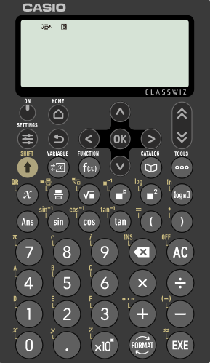
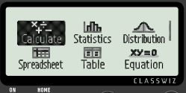

Product of prime factors using index notation
We can use also use scientific calculators to check the prime factors of a number.
Here is the Casio fx-991EX.
Firstly, ensure ‘Calculate’ is highlighted.
Then press ‘EXE’

Slide 28
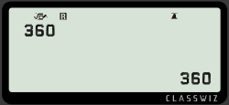
Product of prime factors using index notation
Let’s check the prime factors of 360.
Type in 360 and press ‘EXE’

Slide 29
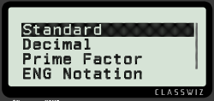

Product of prime factors using index notation
Let’s check the prime factors of 360.
Type in 360 and press ‘EXE’
Then select ‘FORMAT’

Slide 30
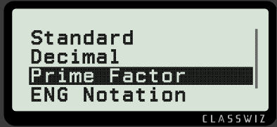

Product of prime factors using index notation
Scroll down until ‘Prime Factor’ is highlighted.
Then press ‘EXE’ again

Slide 31
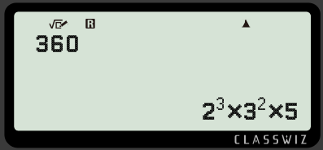
Product of prime factors using index notation
This will reveal the number as a product of its prime factors.
Therefore, we have just checked our prime factors of 360.
360 = 2³ × 3² × 5

Slide 32
Product of prime factors using index notation
Fill in the missing digits.
2 × 2 × 2 × 3 × 3 × 7 × 7 = 2 × 3 × 7
2 × 2 × 5 × 5 × 5 × 11 × 11 = 2 × 5 × 11
5 × 13 × 5 × 5 × 3 × 13 × 3 × 5 = 3 × 5 × 13
17 × 2 × 17 × 7 × 7 × 2 × 17 × 7 × 17 = 2 × 7 × 17
5 × 2 × 5 × 7 × 7 × 11 × 5 × 7 × 11 = 2 × 5 × 7 × 11
Why is there no box for the 2 in e?

Slide 33
Product of prime factors using index notation
2) Use 60 = 2² × 3 × 5 to write the following, without using a calculator, as a product of their prime factors.
120
180
300
600
6000
4200
30

Slide 34
Product of prime factors using index notation
Fill in the missing digits.
2 × 2 × 2 × 3 × 3 × 7 × 7 = 2 × 3 × 7
2 × 2 × 5 × 5 × 5 × 11 × 11 = 2 × 5 × 11
5 × 13 × 5 × 5 × 3 × 13 × 3 × 5 = 3 × 5 × 13
17 × 2 × 17 × 7 × 7 × 2 × 17 × 7 × 17 = 2 × 7 × 17
5 × 2 × 5 × 7 × 7 × 11 × 5 × 7 × 11 = 2 × 5 × 7 × 11
Why is there no box for the 2 in e)?
The index would be 1 which we do not write.
3
2
2
2
3
2
2
4
2
2
3
4
3
3
2

Slide 35
Product of prime factors using index notation
2) Use 60 = 2² × 3 × 5 to write the following, without using a calculator, as a product of their prime factors.
120
180
300
600
6000
4200
= 60 × 2 = 2² × 3 × 5 × 2 = 2³ × 3 × 5
= 60 × 3 = 2² × 3 × 5 × 3 = 2² × 3² × 5
= 60 × 5 = 2² × 3 × 5 × 5 = 2² × 3 × 5²
= 60 × 10 = 2² × 3 × 5 × 2 × 5 = 2³ × 3 × 5²
= 60 × 100 = 2² × 3 × 5 × 2² × 5² = 2⁴ × 3 × 5³
= 60 × 70 = 2² × 3 × 5 × 7 × 10 = 2² × 3 × 5 × 7 × 2 × 5
= 2³ × 3 × 5² × 7
g) 30
= 60 ÷ 2 = 2² × 3 × 5 ÷ 2 = 2 × 3 × 5

Slide 36
Expressing an integer as a product of its prime factors
Numbers greater than 1 are either composite or prime.
Composite numbers can be written as a unique product of prime factors. E.g.
Products of prime factors can be written more efficiently using index notation. E.g.
52
= 2 × 26
= 2 × 2 × 13
52
= 2² × 13

Slide 37

© Oak National Academy 2023.
Produced in partnership with Mathematics in Education and Industry.
Licensed on the Open Government Licence v3.0, except where otherwise stated. See Oak terms and conditions.

